Slide 1

Azure Banking Data Platform Project
Presented by: Niroop
Date: 10-12-2025

Slide 2



Project Objective
Building a modern, enterprise-grade banking data platform engineered for performance, security, and scalability.
Unified Data View
Real-Time Processing
Advanced Analytics
Consolidated ATM, UPI, and customer data across all channels
Instant ingestion, alerting, and fraud detection capabilities
With Power BI dashboards
Delta Lakehouse
SQL Data Warehouse
Scalable ETL with Bronze-Silver-Gold architecture
Star schema design for enterprise reporting
Enterprise Security
Automated CI/CD
Private endpoints
Streamlined deployment pipeline

Slide 3
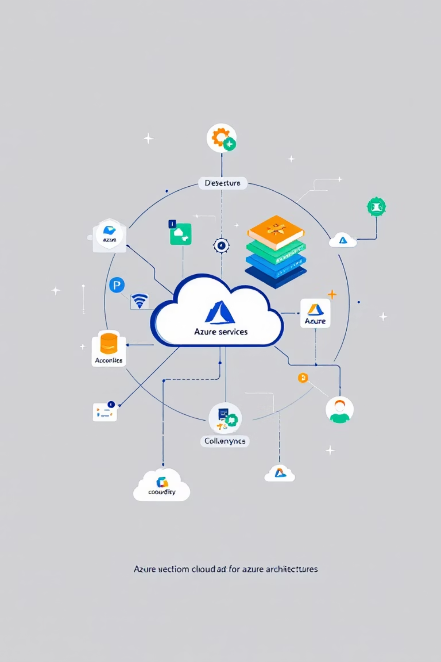



End-to-End Architecture Overview
Real-Time Stream
ADLS → Event Grid → Azure Function → Service Bus → Cosmos DB
Batch ETL Pipeline
ADLS → Databricks (Bronze/Silver/Gold) → Delta Lake → SQL DW
Analytics Layer
SQL Data Warehouse → Power BI visualizations

Slide 4

Ingestion Pipeline Implementation
01
02
ADLS Gen2 Storage
Function App
Storage account: banksourcedata
Python-based: Bank-Func-app
Organized folders: raw/atm, raw/upi, raw/customers
Event-driven processing with automatic scaling
03
04
Event Grid Subscription
Service Bus Queue
Captures blob creation events instantly
Namespace + queue: queue_ingestion
Triggers downstream processing workflows
Reliable message delivery and buffering
Purpose: Trigger real-time ingestion instantly when new banking data files arrive in storage, ensuring zero-latency processing.

Slide 5
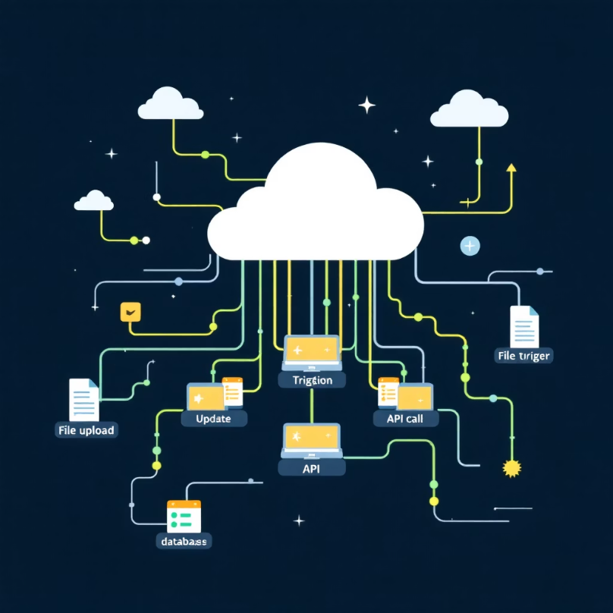

Event Processing Logic
Event Grid Trigger Function
Queue Trigger Function
Detects new blob upload events
Reads Service Bus messages
Validates CSV file format and structure
Fetches original blob content
Extracts metadata: file name, URL, source type
Validates against schema definitions
Logs detailed audit trail
Removes duplicate records
Sends structured JSON → Service Bus
Classifies: ATM/UPI/CUSTOMER
Prepares records for operational store
Azure Functions provide serverless, scalable processing with automatic retry logic and built-in monitoring capabilities.

Slide 6




Operational Data Store: Cosmos DB
Processed data flows into Cosmos DB collections optimized for low-latency access and global distribution.
ATMTransactions
UPIEvents
Complete ATM event history
UPI debit and credit events
Withdrawal, deposit, balance inquiry records
Real-time payment transaction logs
AccountProfile
FraudAlerts
Enriched customer profiles
Real-time fraud flags
Demographics, account details, preferences
High-value, velocity, geo-location alerts
Purpose: Low-latency operational store powering applications, real-time fraud monitoring, and instant analytics queries with millisecond response times.

Slide 7


Databricks Lakehouse Architecture
Three-tier Delta Lake architecture ensures data quality, governance, and analytics-ready datasets.
Bronze Layer
Silver Layer
Gold Layer
Raw ingestion zone
Cleansed and standardized
Business-ready analytics
Reads ATM, UPI, Account Profile, and KYC text files
Type casting for dates, amounts, currencies
Curated Dim & Fact tables
SCD Type-2 dimensions for historical tracking
Stores raw JSON/text exactly as received
Null/invalid value cleanup
Currency normalization to INR
Aggregated ATM + UPI transaction dataset
No transformations or casting
Join Account + Customer to create unified customer profile
Original schema preserved for lineage
Monthly/branch/channel level performance insights
ATM & UPI geolocation enrichment (lat/long + reverse geocode)
Ready for Power BI dashboards and fraud analysis
Standardize both channels into a single transaction schema

Slide 8

SQL Data Warehouse Model
Dimension Tables
1
2
dim_customer
dim_account
Built from unified Account–Customer Silver data
Account number, type, status, branch, open date, balance (INR)
Includes personal, KYC, and demographic attributes
Linked to customer via CustomerID
SCD Type 2 implemented with ValidFrom/ValidTo/IsCurrent
3
4
dim_kyc
dim_date
Parsed from raw text files
Generated calendar table
Document type, KYC status, document ID
Year, Month, Day, Week, Quarter
Fact Tables
1
2
fact_transactions
fact_customer_profile
Union of ATM + UPI standardized transactions
Transaction count + total spending per customer
Timestamp, amount, channel, geo coordinates
Derived from fact_transactions
Joined to Date dimension
ETL Process
PySpark MERGE and UPSERT operations ensure efficient incremental loads with full SCD2 history preservation.

Slide 9
Real-Time Fraud Detection Pipeline
Advanced rule engine analyzes transactions in real-time, triggering alerts for suspicious patterns.
Fraud Detection Rules
High Value Fraud
1
Triggers HIGH_VALUE alert when any transaction ≥ ₹50,000
Velocity Fraud
2
Creates VELOCITY_ATTACK alert for 10+ transactions within 2 minutes
Geo-Location Switching
3
Raises geographic alert when transactions occur from different cities within 10 minutes
Balance Drain
4
Triggers alert when total withdrawals exceed ₹100,000 within 10 minutes

Slide 10
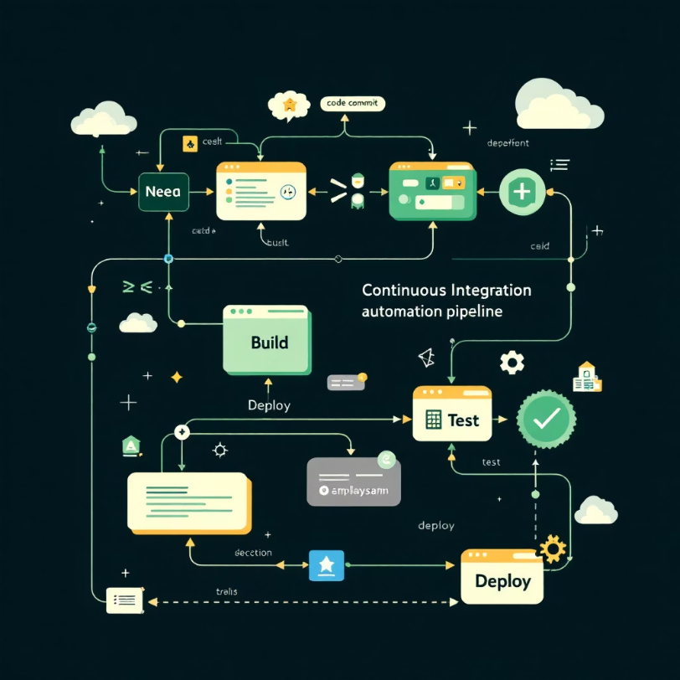




CI/CD & Power BI Insights
Streamlined CI/CD Pipeline
Power BI Visualisation
Azure Functions
Power BI Dashboards
Deployment Center with auto GitHub Deploy integration
Customer 360 insights
Fraud operations center
Databricks
Branch performance metrics
ATM and UPI analytics
Repository auto-sync for instant notebook updates
Compliance reporting
Infrastructure
Manual management for speed and simplicity

